Slide 1
Artificial intelligence: disease or panacea?

Slide 2
The main reason is misunderstanding.

Slide 3
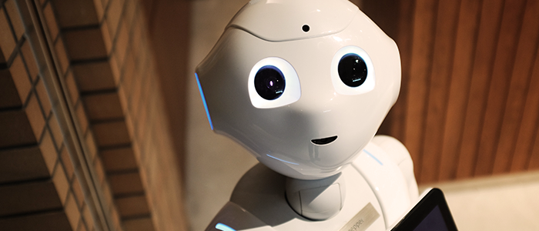
Robots are innocent

Slide 4
Artificial - made or produced by human beings rather than occurring naturally
Intelligence - the ability to acquire and apply knowledge and skills.

Slide 5
How did people come to this transition?

Slide 6
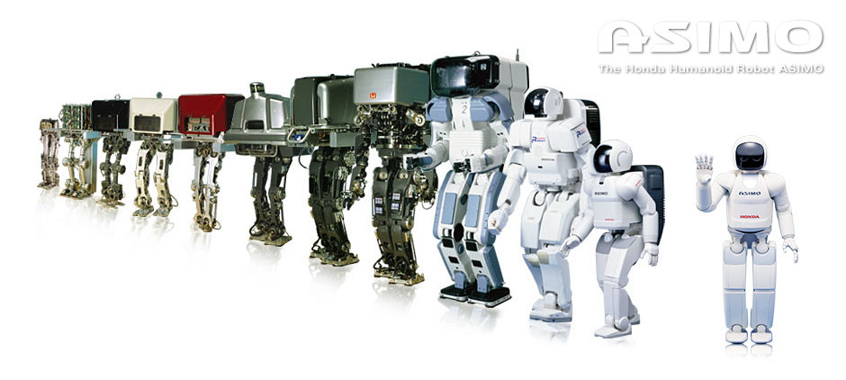
From Wabot-1 to Asimo

Slide 7
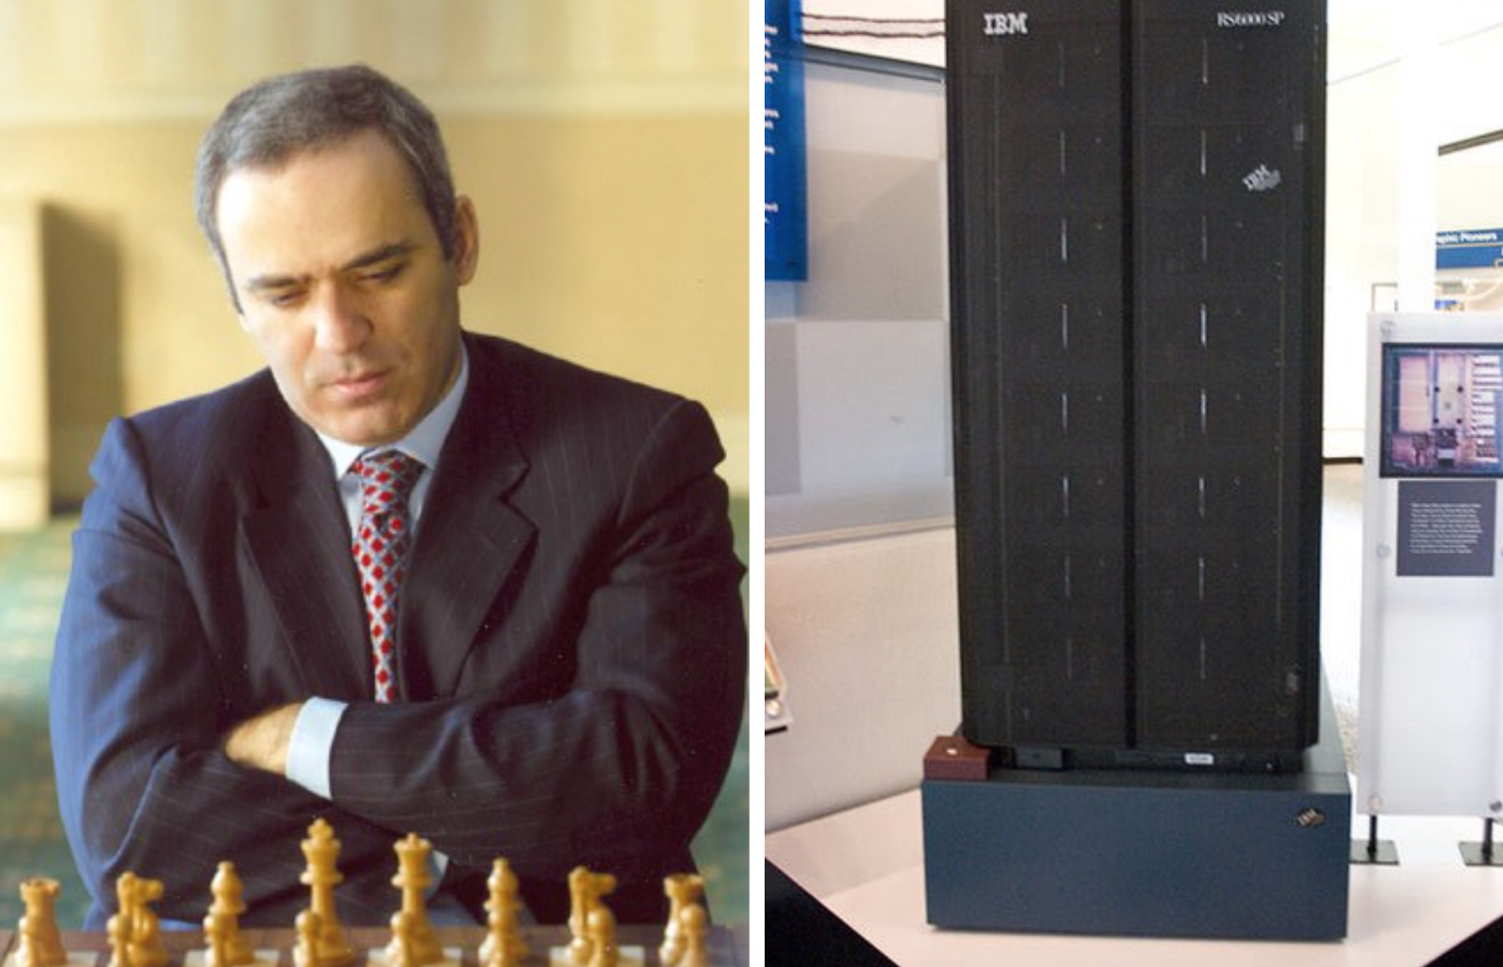

Slide 8
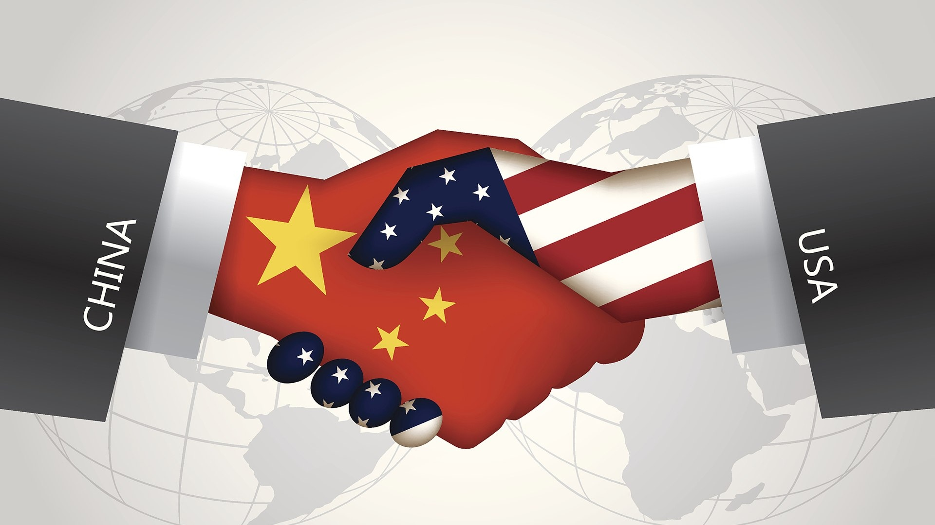

Slide 9
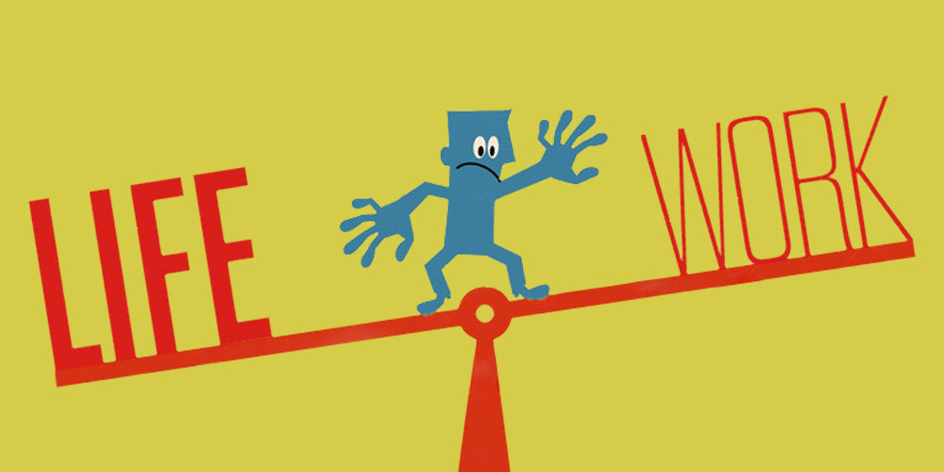

Slide 10
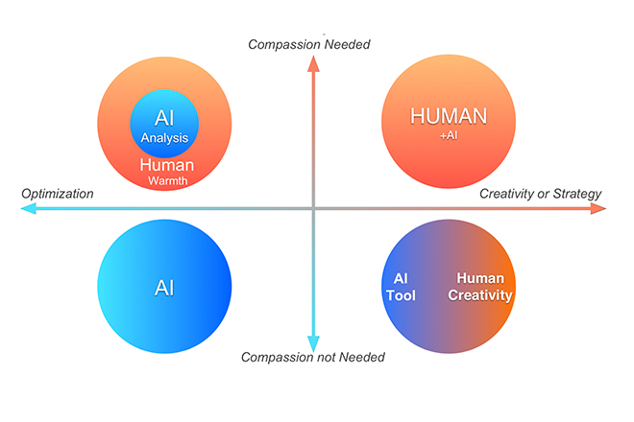

Slide 11
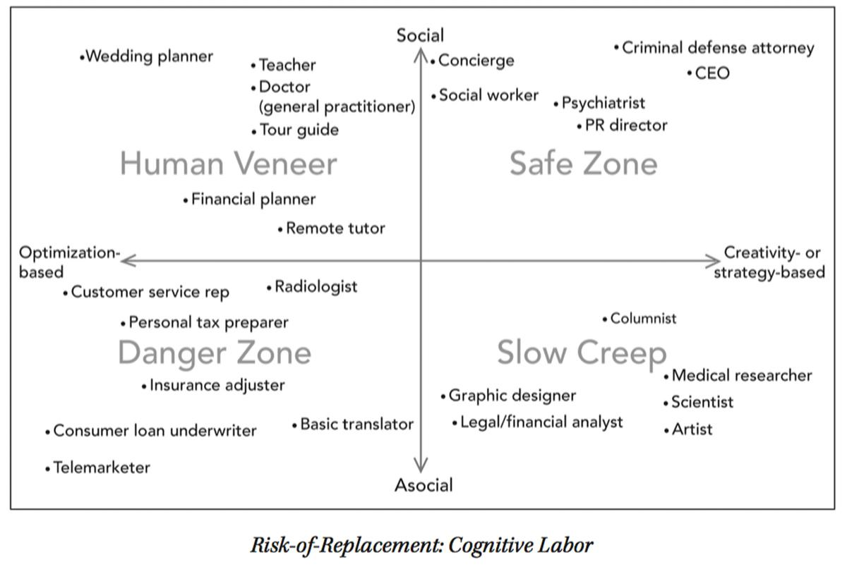

Slide 12
